Slide 1
Torbay Conservation Area Appraisals
Torquay Harbour
Public Consultation 2025
Old Paignton
Brixham
Town

Slide 2
What is a Conservation Area Appraisal?
Torbay Council have a duty to recognise areas which have special architectural or historic interest and to designate these as conservation areas.
These should be reviewed from time to time, in line with relevant legislation.
The Torquay Harbour, Old Paignton and Brixham Town Conservation Areas are all due for a renewed appraisal.
The purpose of a conservation area appraisal is to:
Summarise the history of the area.
Recognise the important buildings, spaces and other features which are characteristic of the area.
Identify any issues which detract from what makes the conservation area special.
Recognise opportunities for enhancement.
Provide guidance on how to look after and protect what makes the conservation area special.

Slide 3
Understanding what is important
The importance and special interest of a conservation area can come from multiple themes, including:
Types of architecture – either individual or uniform groups
Building materials and features
Street layout
Key views and open spaces
Topography
Archaeology

Slide 4
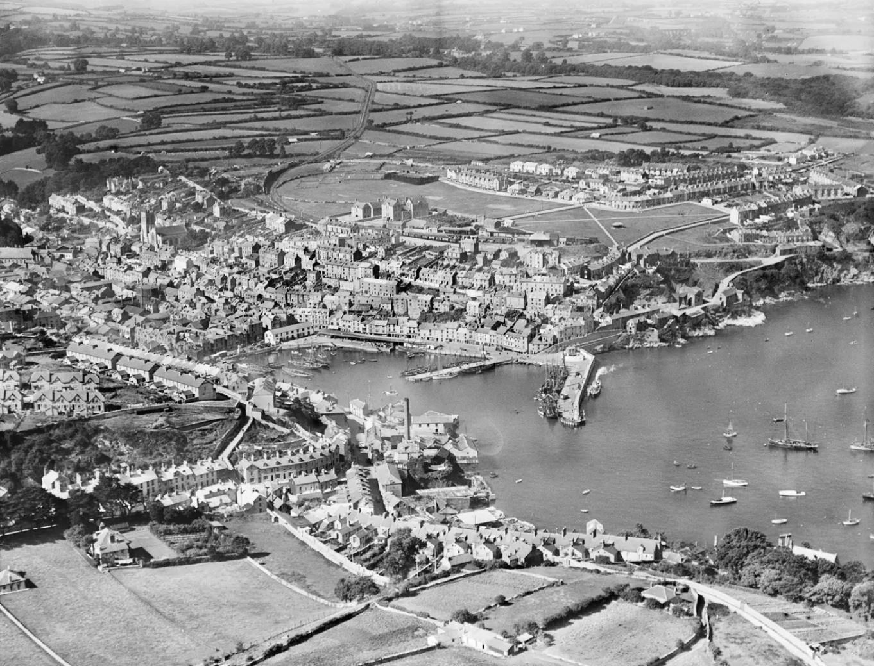
Brixham Town
Summary of special interest
Historical interest: a small fishing port and naval supply station, with rapid growth in the 19th century.
Topography and configuration: distinctive slope directing the development in the town, interconnecting small alleys and flights of steps, with striking vistas and glimpsed views
Architecture: 18th, 19th and early 20th – century terraces, as well as many other attractive historic buildings telling Brixham’s industrial past and its evolution

Slide 5
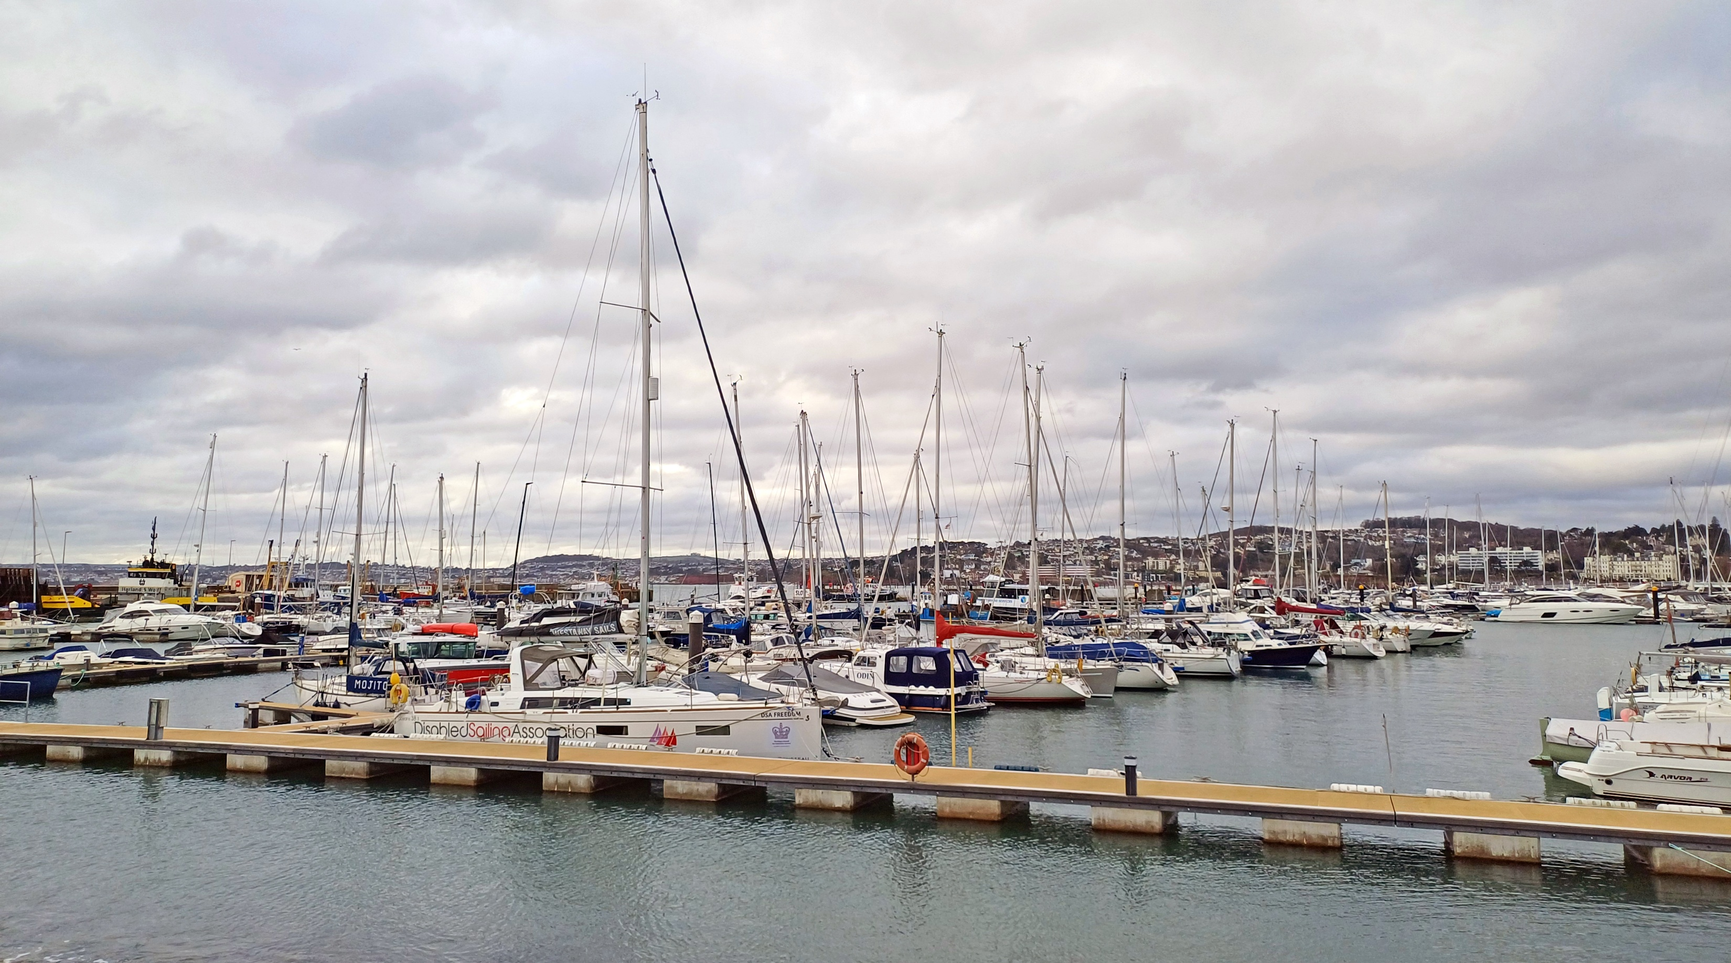
Torquay Harbour
Summary of special interest
Historical interest: growth as a high-end resort town in the late 18th and 19th centuries, and association with Agatha Christie
Topography and configuration: distinctive layers of development climbing up the cliffs and valley slopes, with interconnecting flights of steps and striking views of the harbour and wider town. Contrast between the wide commercial streets and narrower proportions of residential areas.
Architecture: buildings from the 19th and 20th centuries, illustrating the transition from a small fishing port into a prestigious resort, as well as the evolution of architectural fashion

Slide 6
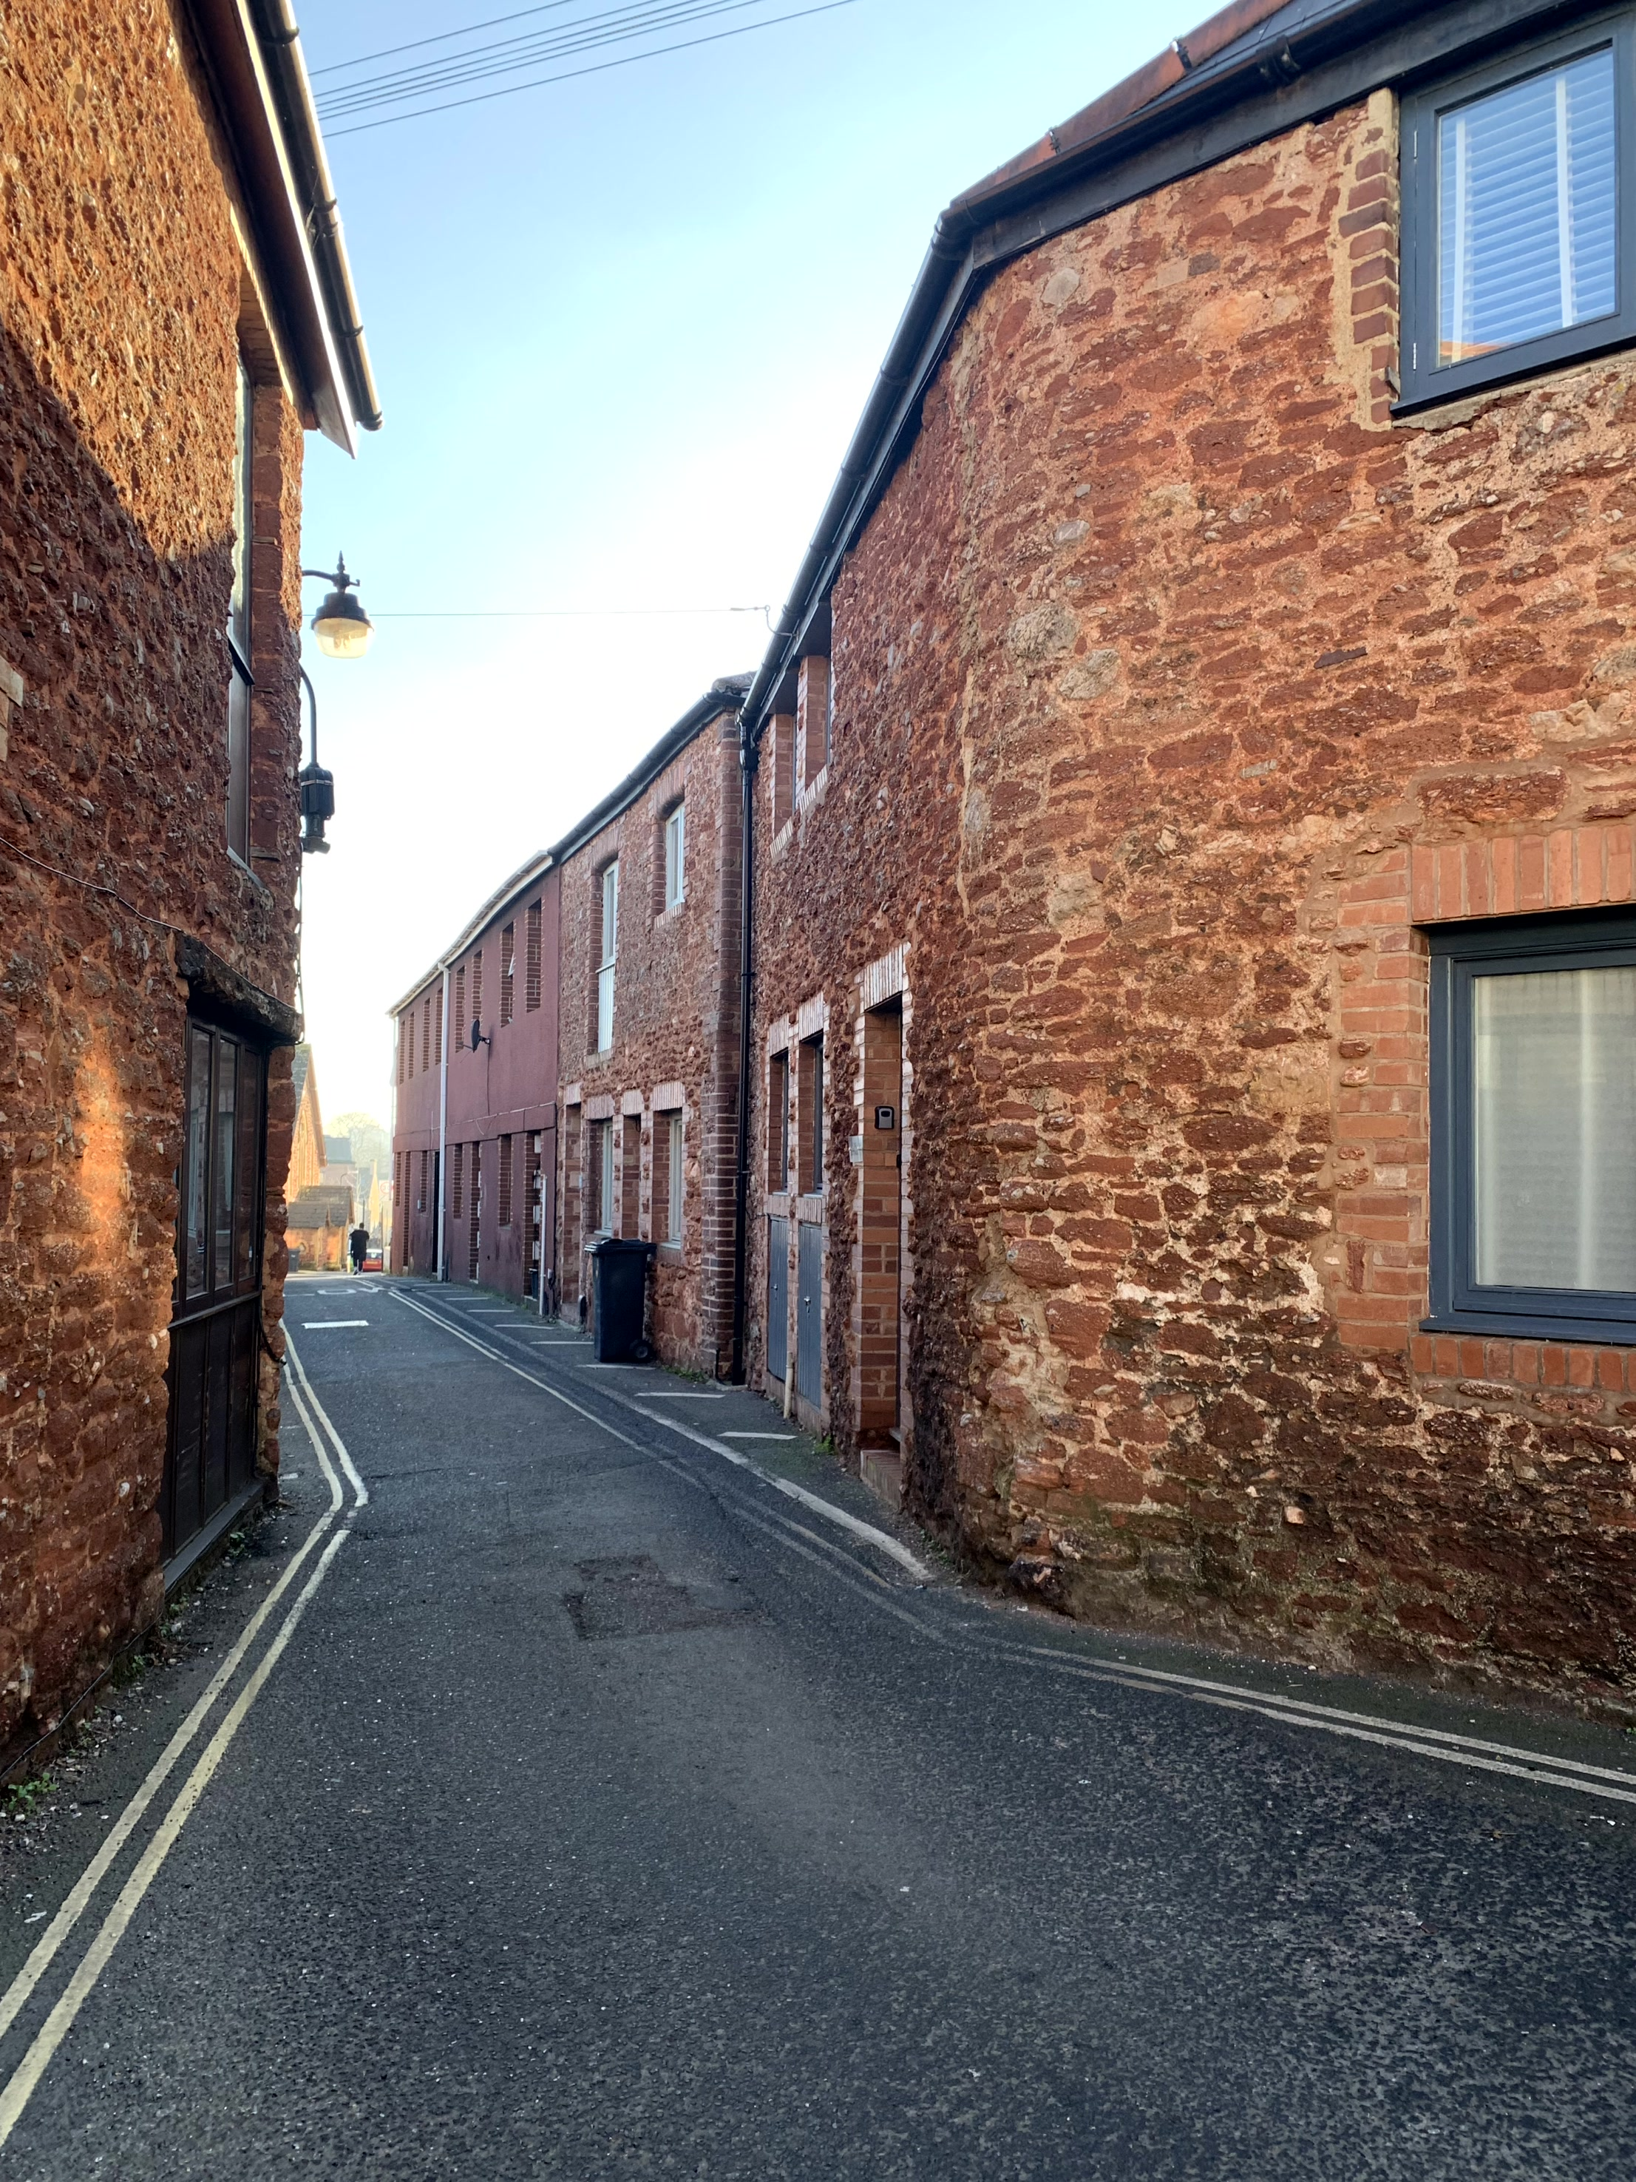
Old Paignton
Summary of special interest
Historical interest: preserved medieval street pattern around Winner Street and Church Street with expansive 19th and 20th – century developments to the south and east which illustrate the rapid growth of the town as a seaside resort.
Topography and configuration: the historic core is self-contained and lies inland at the base of a steep slope
Architecture: wide range of architectural typologies, predominantly 19th-century, evidencing the town’s expansion

Slide 7
Positive contributors, key buildings and local landmarks
Not everything in a conservation area will be equally important. As well as listed buildings and scheduled monuments, conservation areas recognise:
Positive contributors - any building, structure or feature which beneficially add to the overall character of the area, often in groups.
Key buildings which have individual heritage merit.
Local landmarks, which will be visually prominent.
Each appraisal has a full list of addresses and a map.

Slide 8
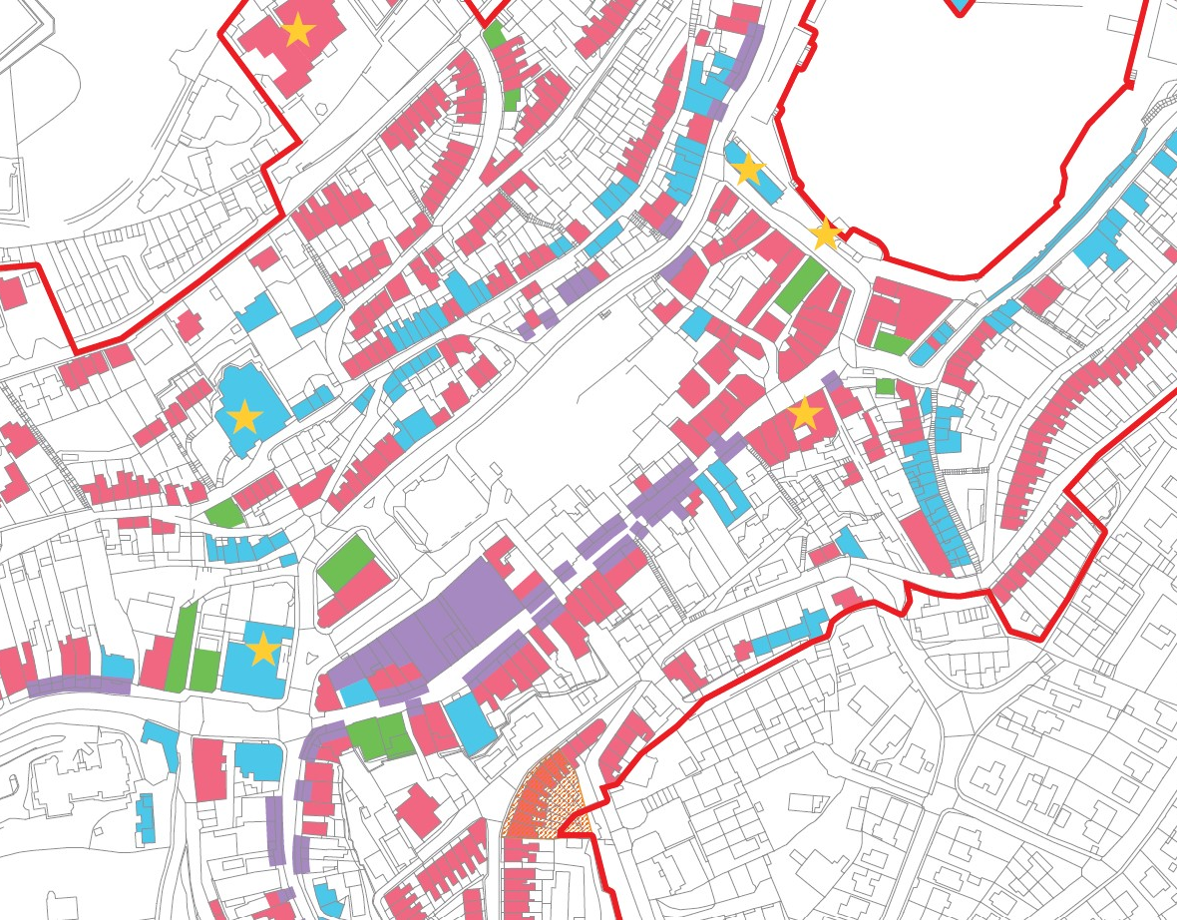
This is an extract of the heritage assets map in the Brixham Town Conservation Area. The full version is available in the appraisal.
Brixham Town – heritage assets

Slide 9
This is an extract of the heritage assets map in the Torquay Harbour Conservation Area. The full version is available in the appraisal.
Torquay Harbour– heritage assets

Slide 10
This is an extract of the heritage assets map in the Old Paignton Conservation Area. The full version is available in the appraisal.
Old Paignton – heritage assets

Slide 11
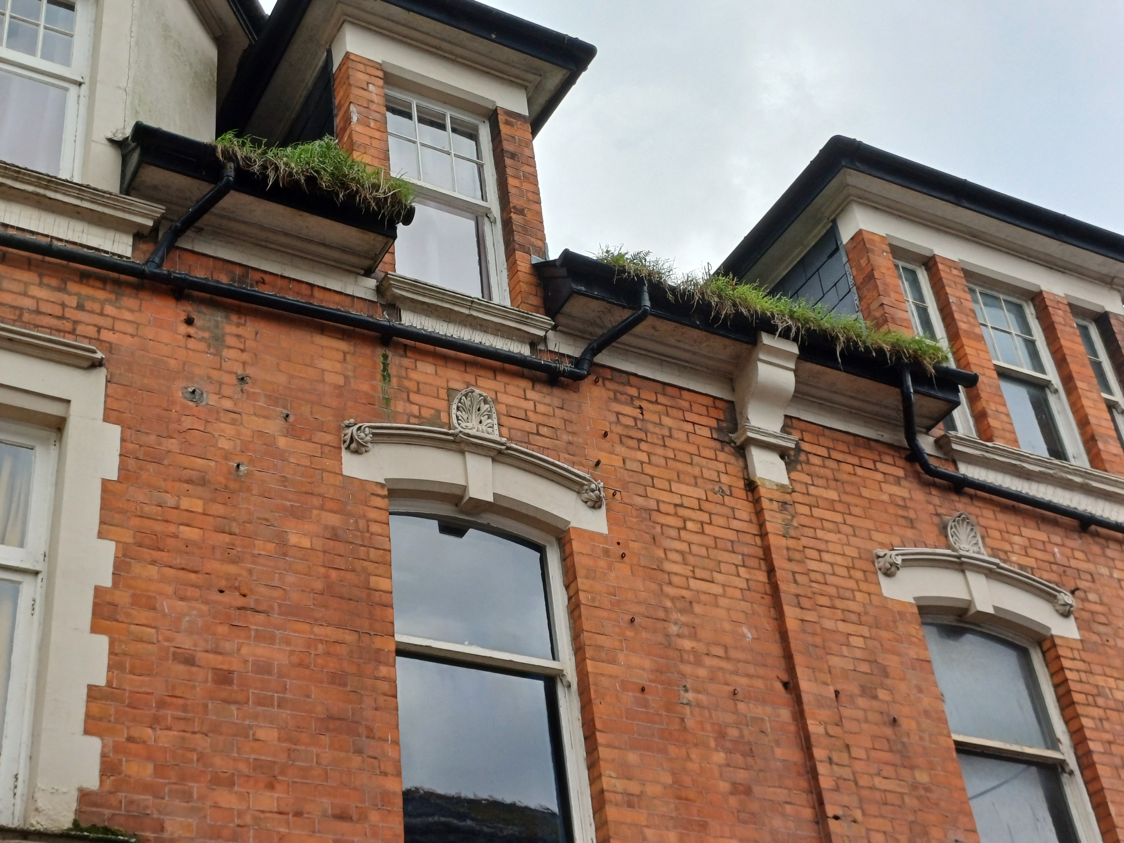
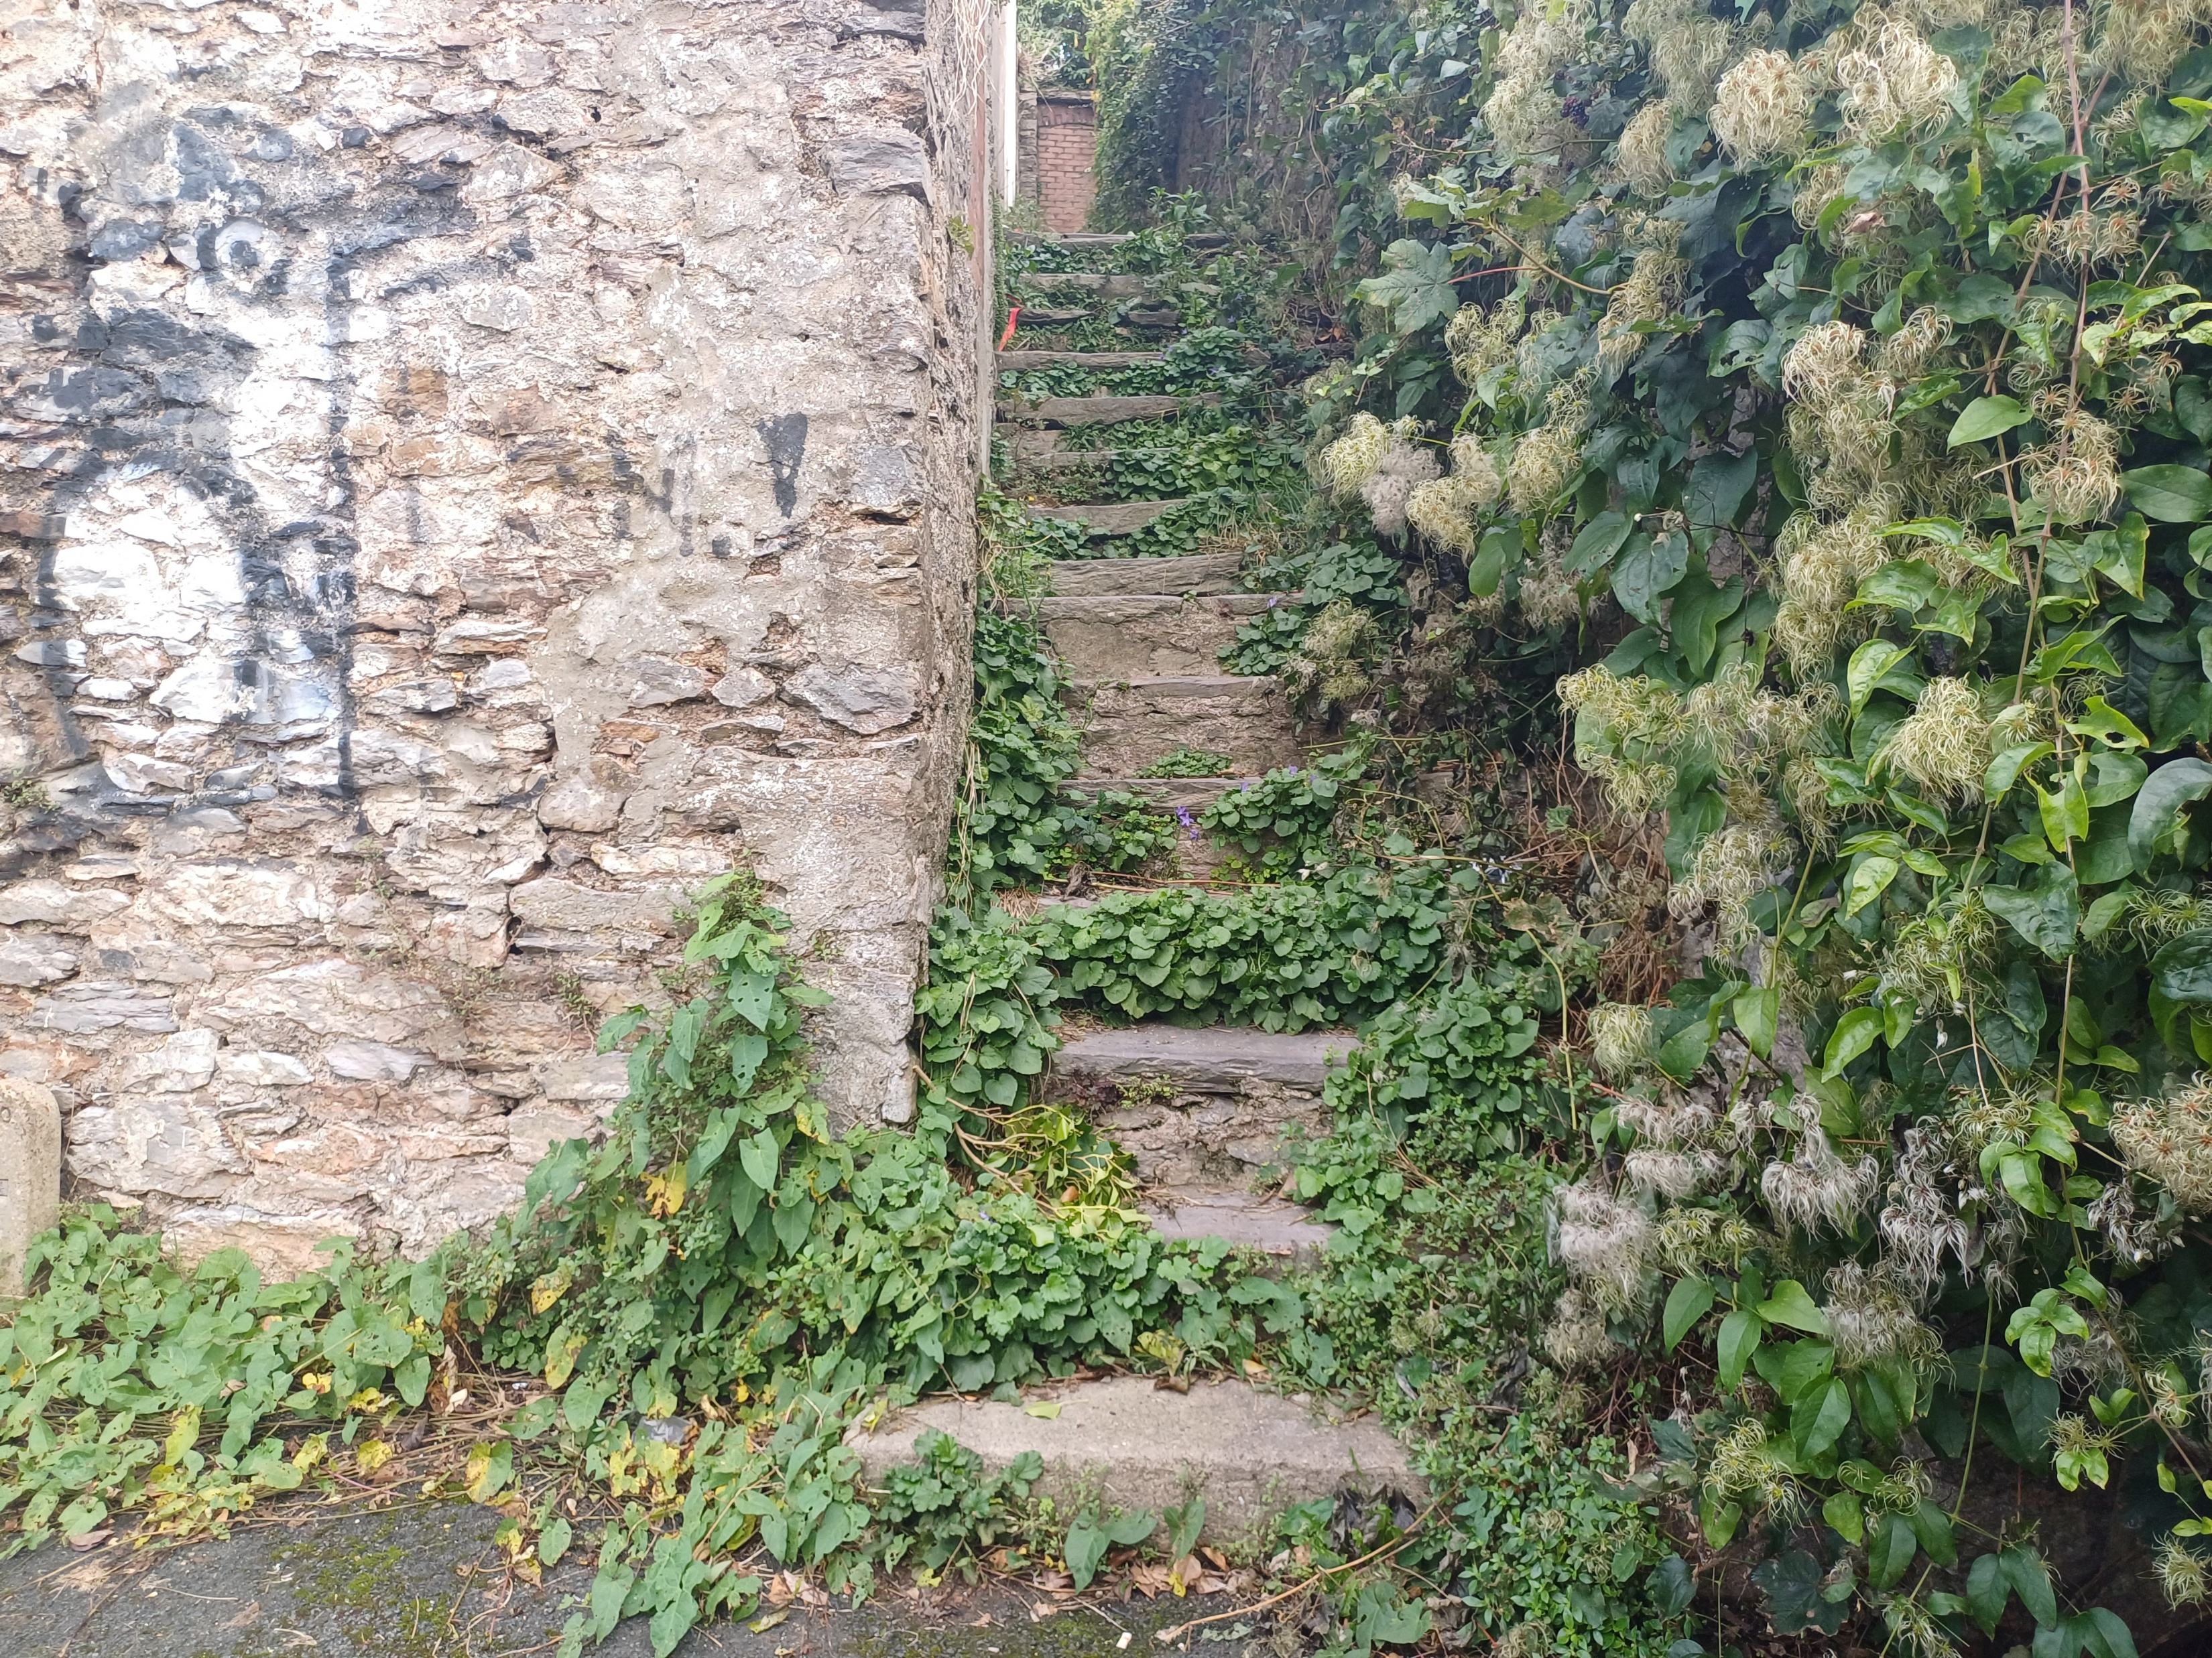
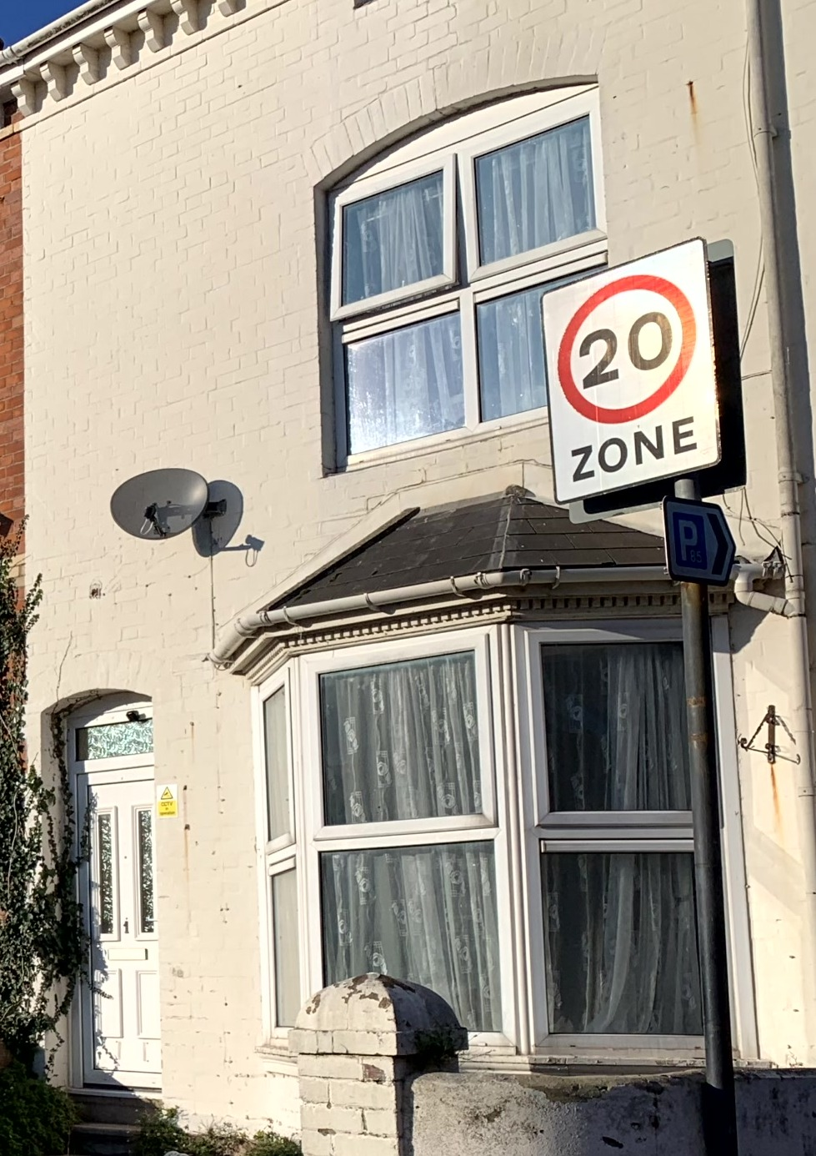
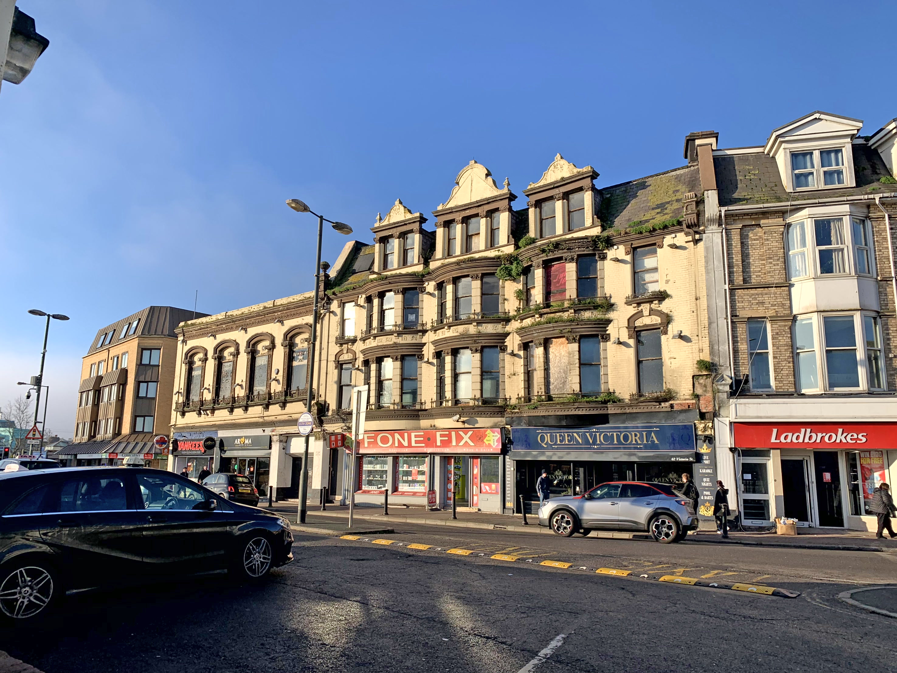
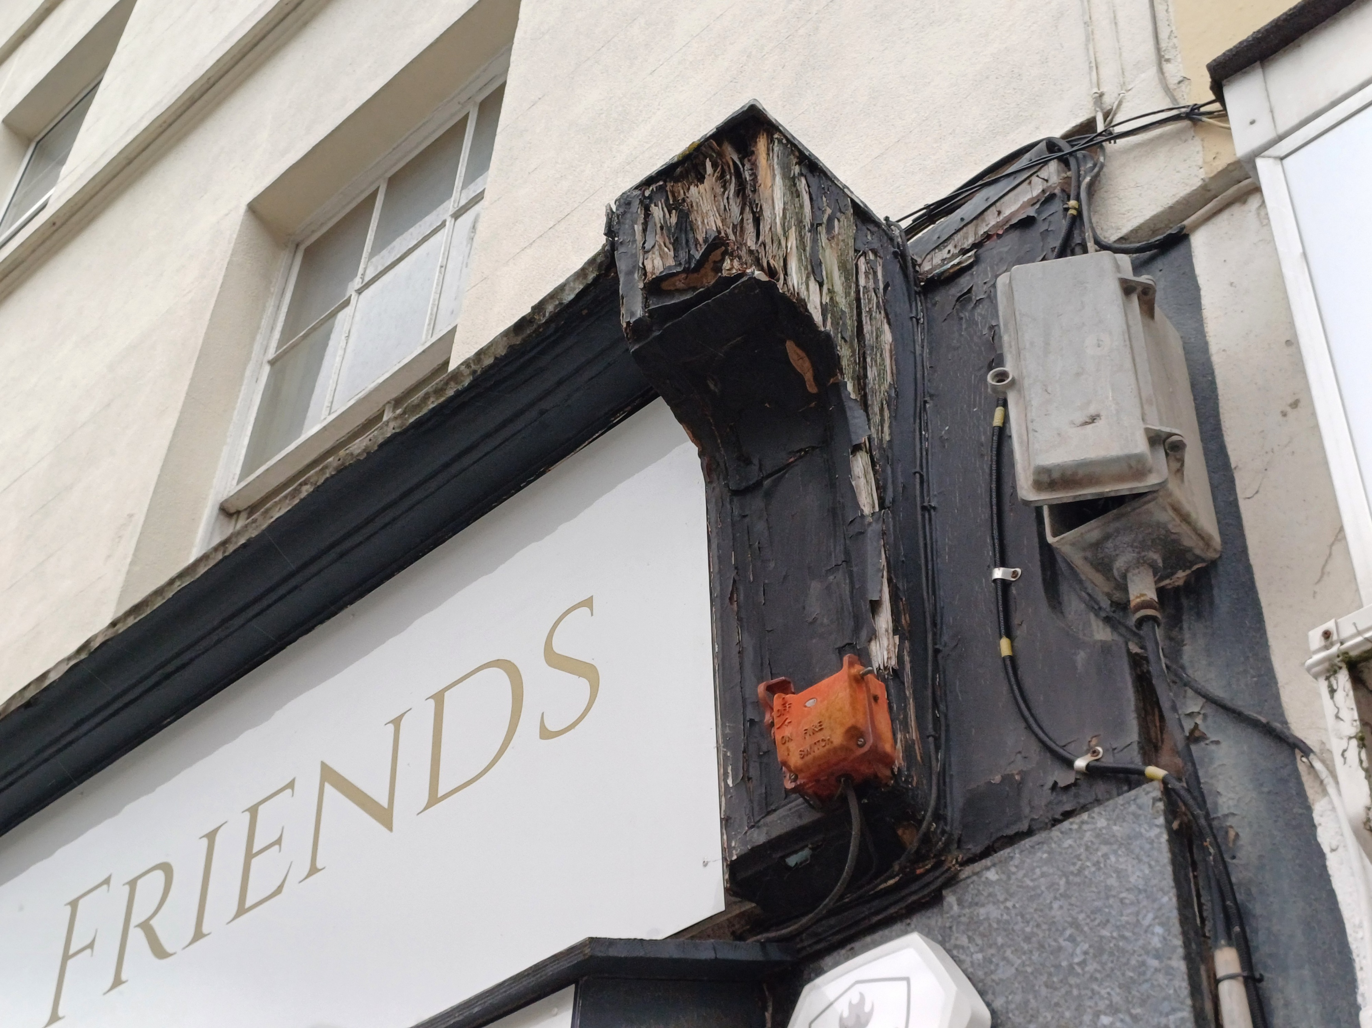
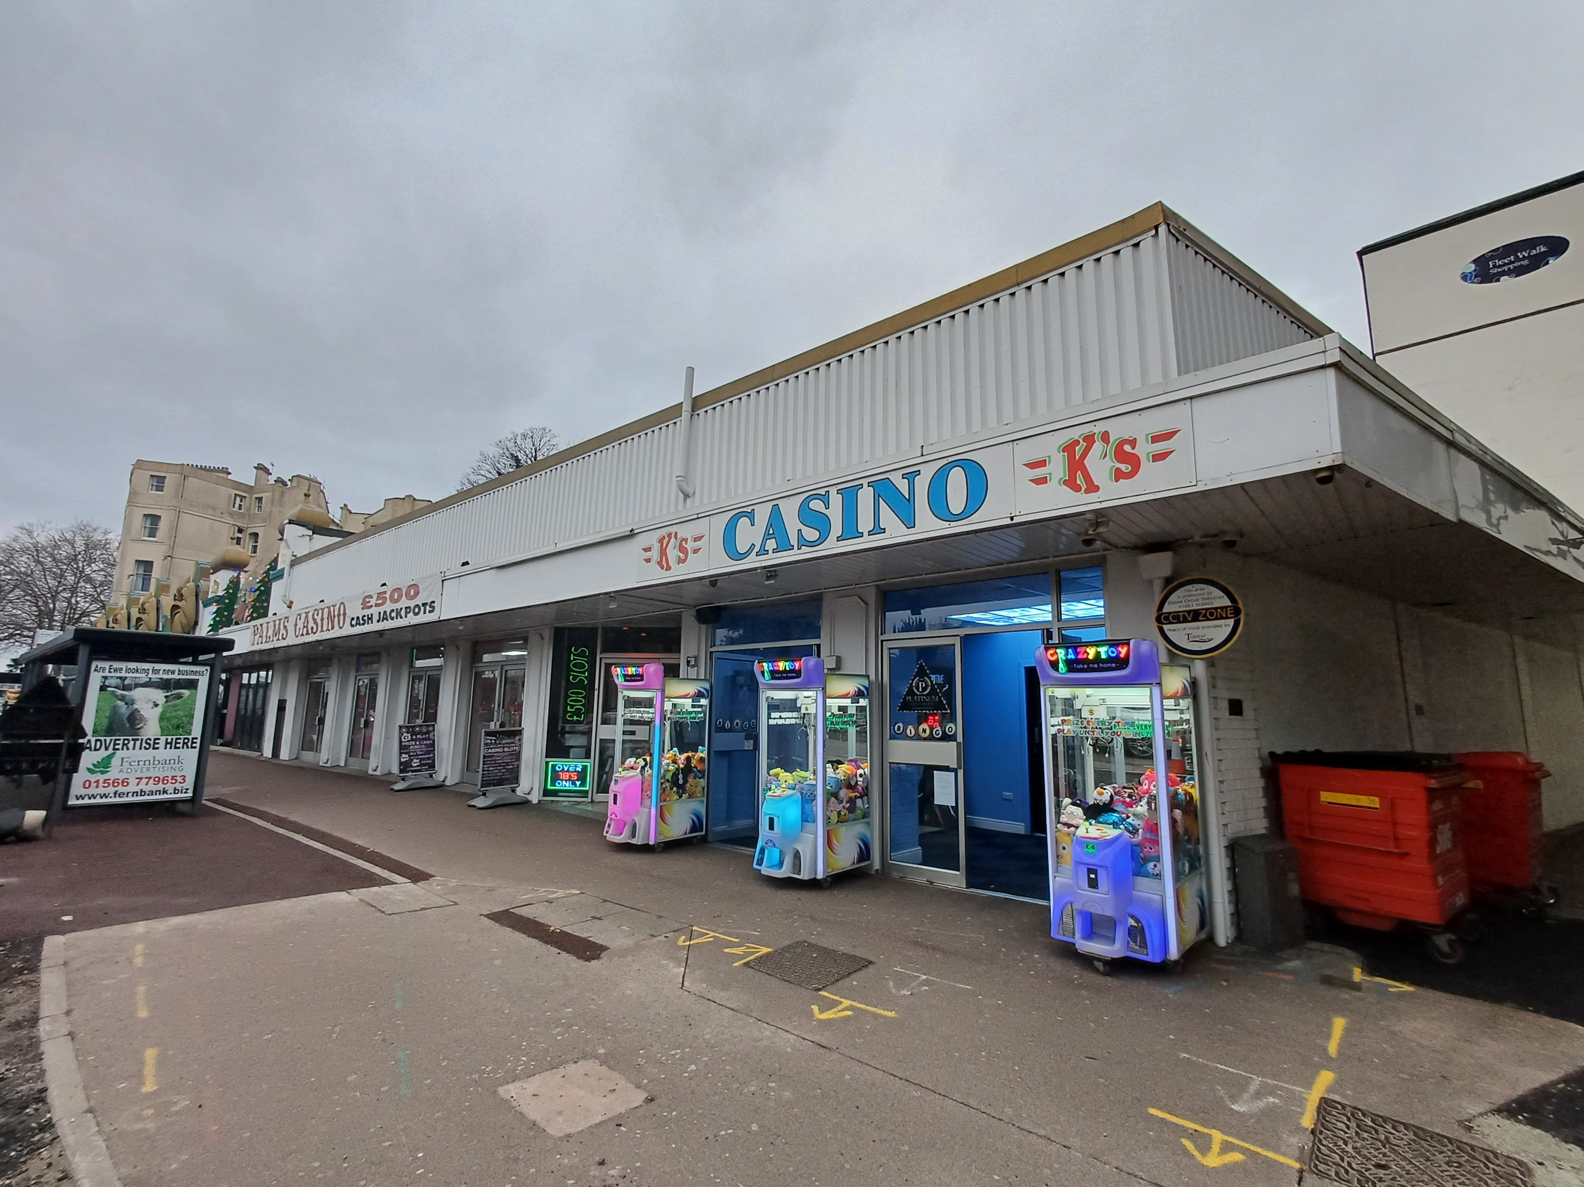
Issues
Common issues across all conservation areas include:
uPVC (plastic) windows
Overgrown vegetation
Blocked gutters
Detracting modern features
Poor building condition

Slide 12
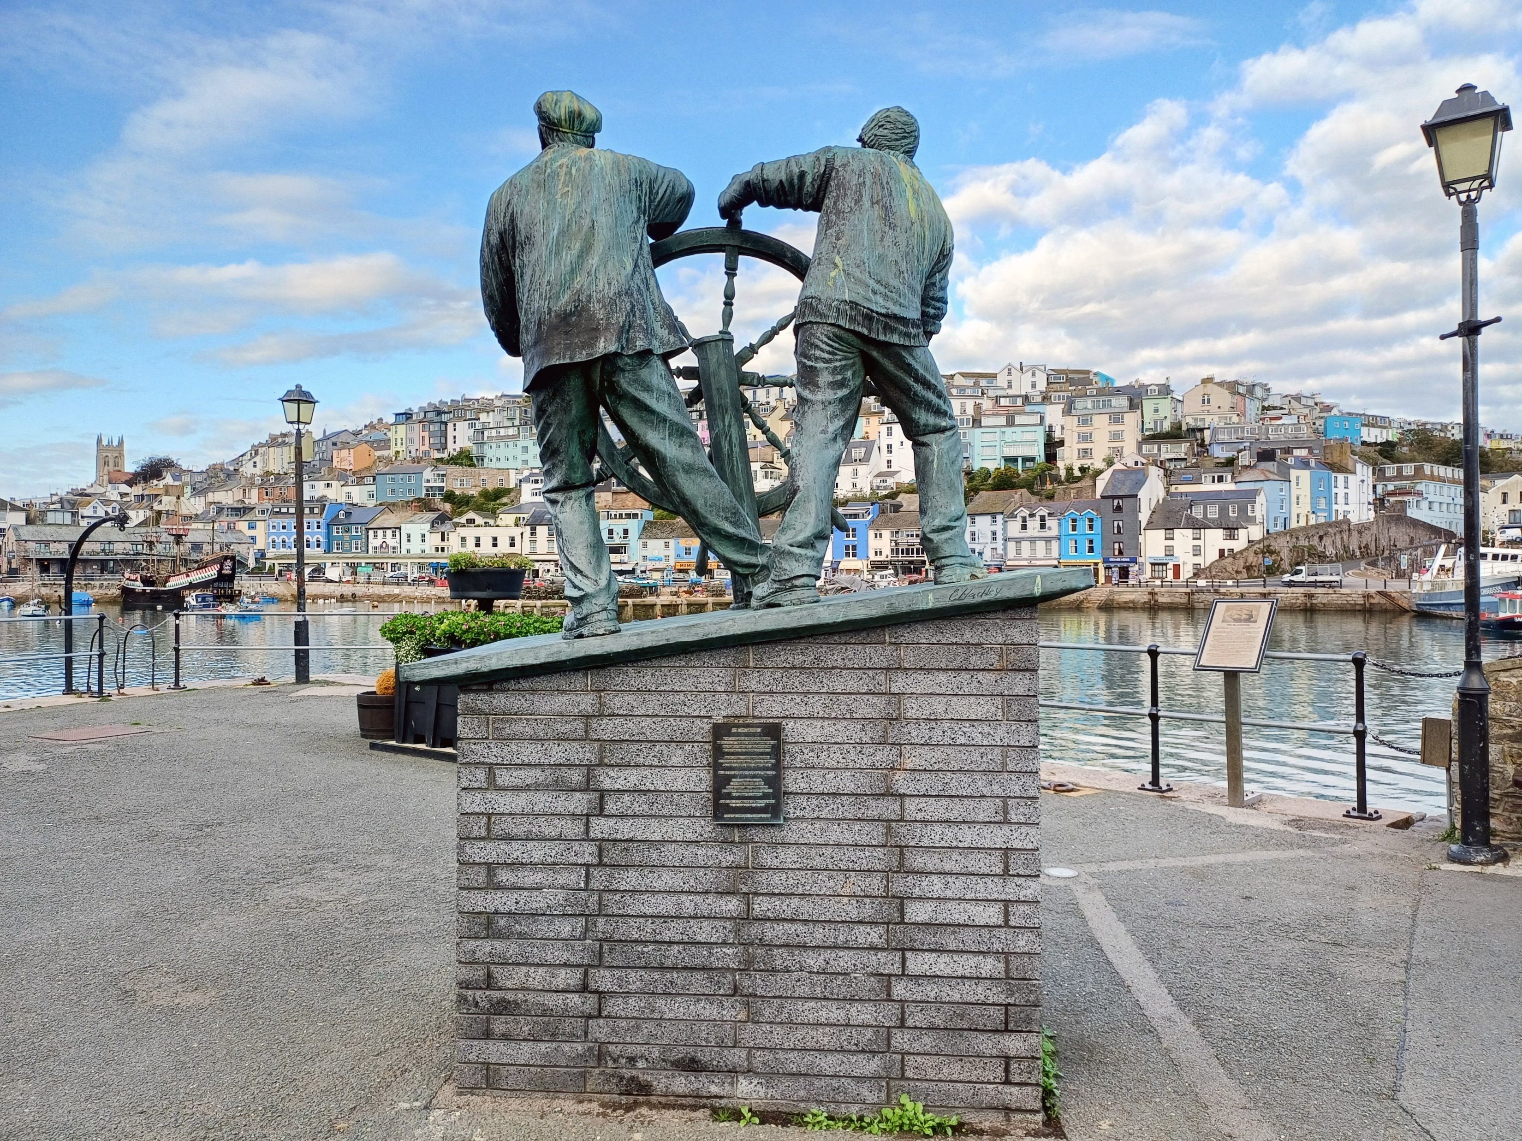
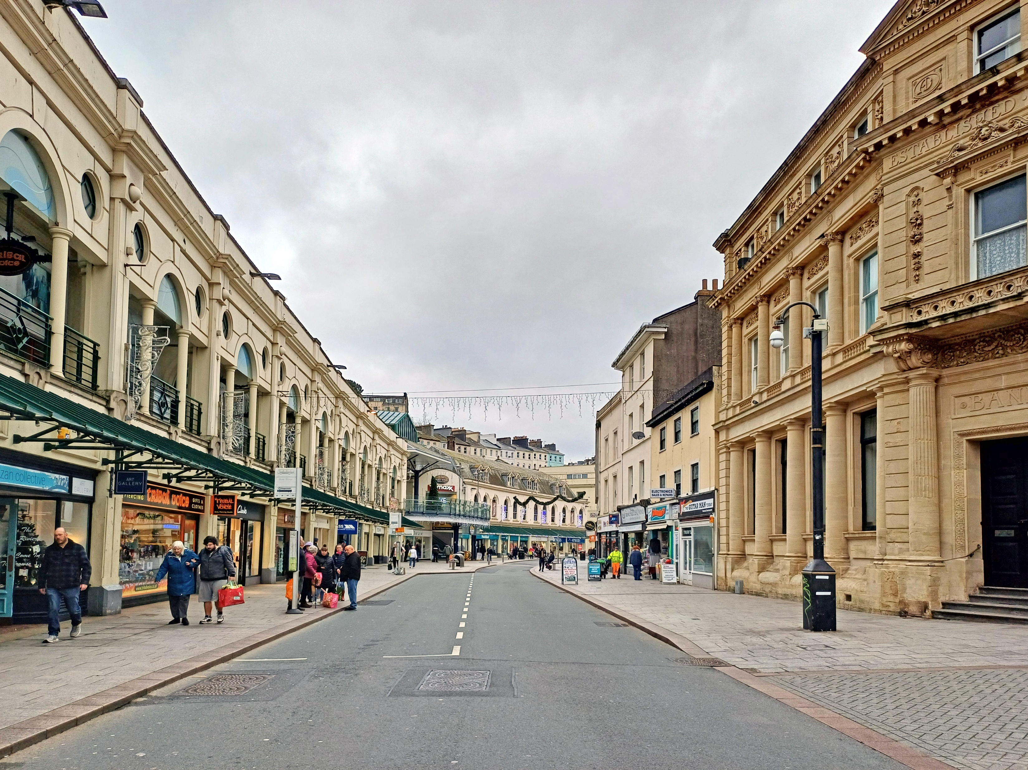
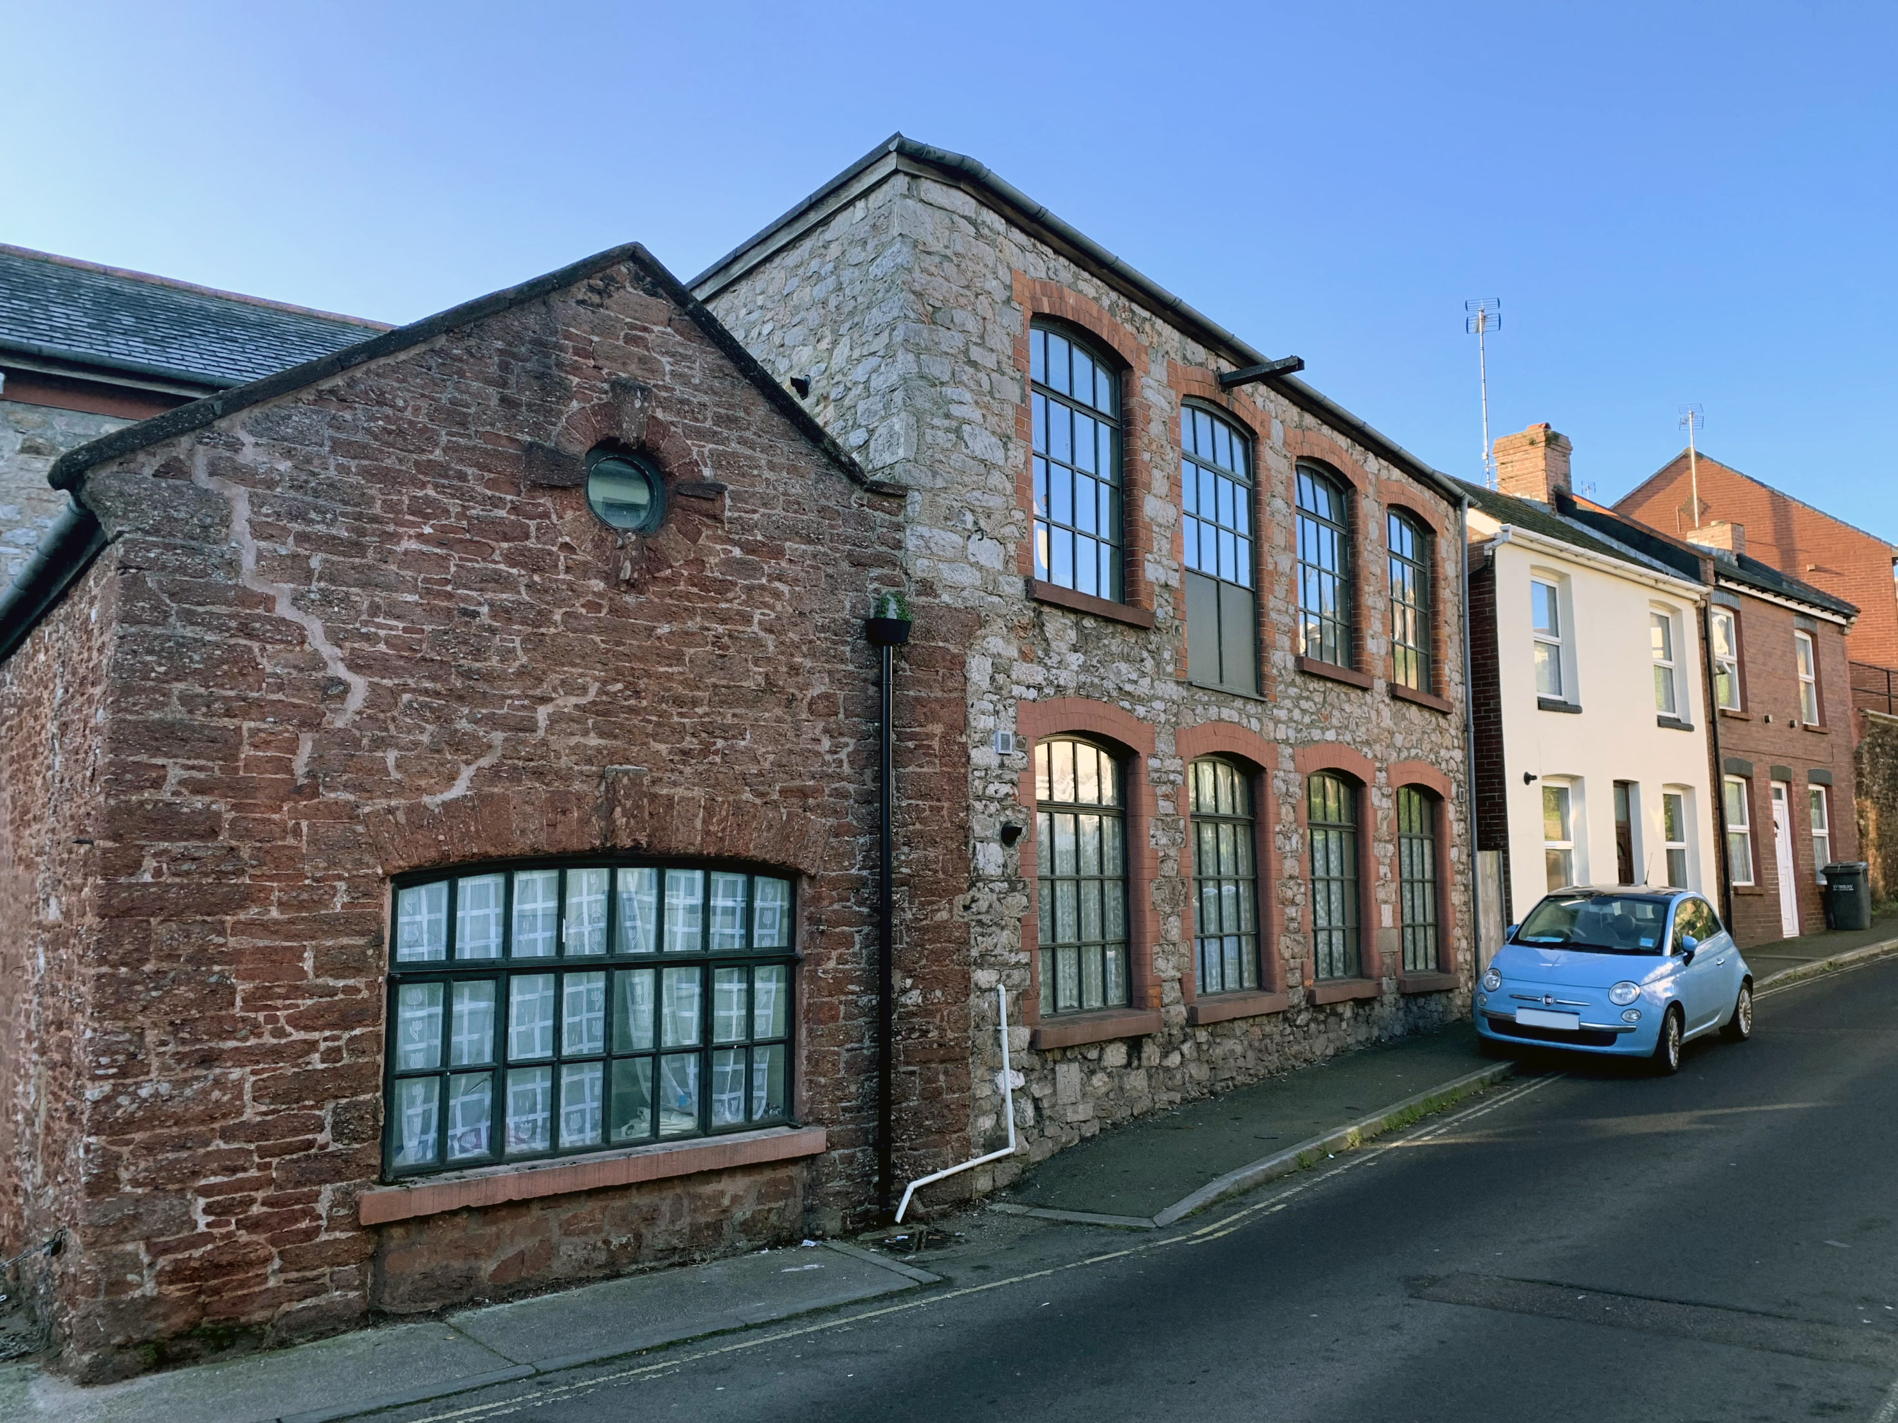
Opportunities
Common themes across all conservation areas include:
Regular maintenance
Appropriate window and door replacement
Quality place making and public realm works
Traditional shopfronts

Slide 13
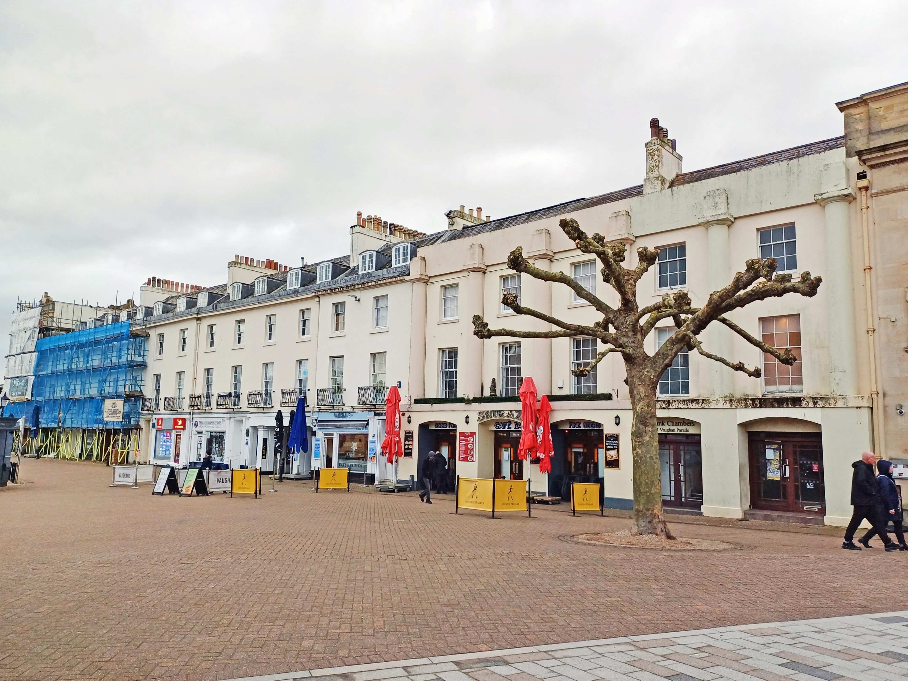
Control measures and best practices
Each appraisal concludes with an overview of the protocols which will help ensure the special interest of the conservation areas are protected, including:
Repairs and replacements
Maintenance
Managing trees
Designing new development
Environmental sustainability upgrades

Slide 14
Further information and useful contacts
Further information is available on the Torbay Council Website www.torbay.gov.uk
Useful Contacts
Heritage & Design Team - heritageanddesign@torbay.gov.uk

